Slide 1
Exception Handling
By
Sana Mateen

Slide 2
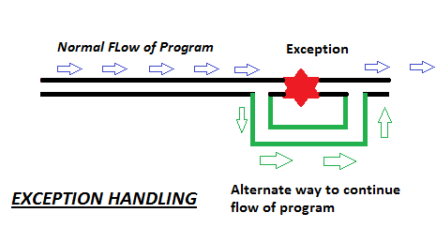
Exception Handling
The exception handling in java is one of the powerful mechanism to handle the runtime errors so that normal flow of the application can be maintained.
What is exception?
Meaning: Exception is an abnormal condition.
In java, exception is an event that disrupts the normal flow of the program. It is an object which is thrown at runtime.
What is exception handling?
Exception Handling is a mechanism to handle runtime errors such as ClassNotFound, IO, SQL, Remote etc.

Slide 3
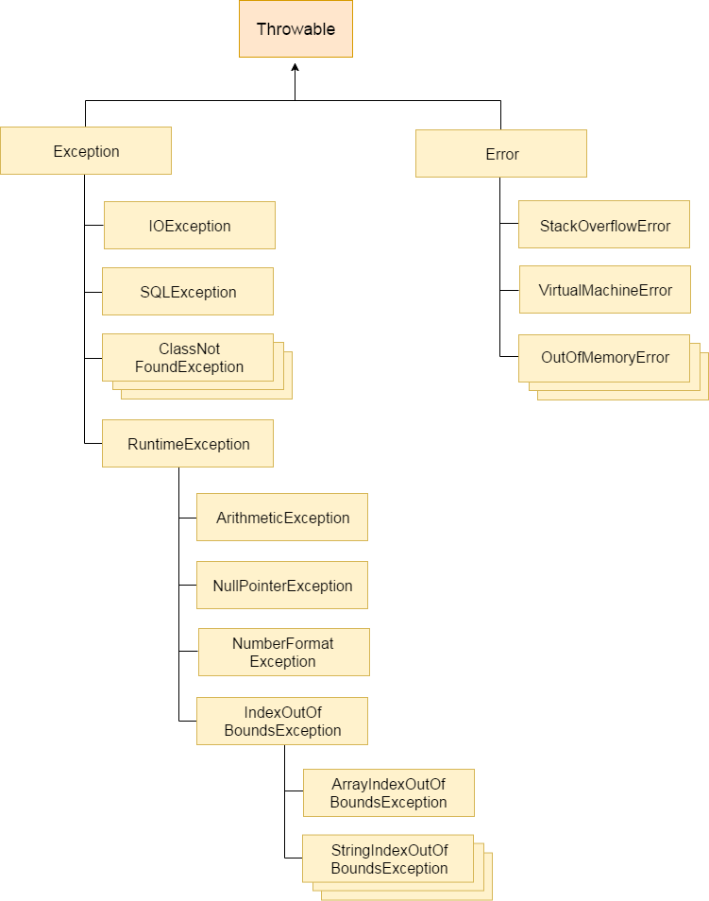

Slide 4
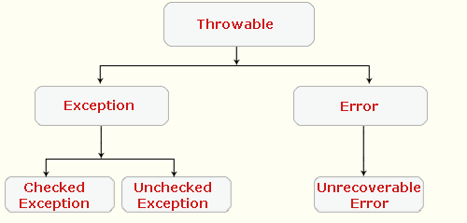
Types of Exception
There are mainly two types of exceptions: checked and unchecked where error is considered as unchecked exception. The sun microsystem says there are three types of exceptions:
Checked Exception
Unchecked Exception
Error

Slide 5
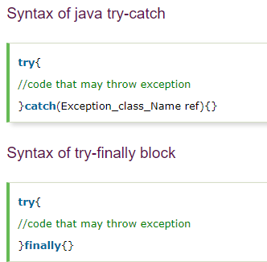
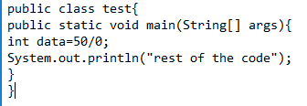
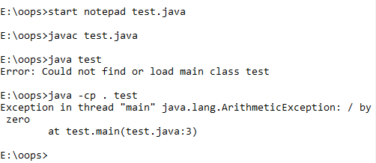
Java try-catch
Java try block is used to enclose the code that might throw an exception. It must be used within the method.
Java try block must be followed by either catch or finally block.
Java catch block
Java catch block is used to handle the Exception. It must be used after the try block only.
You can use multiple catch block with a single try.

Slide 6
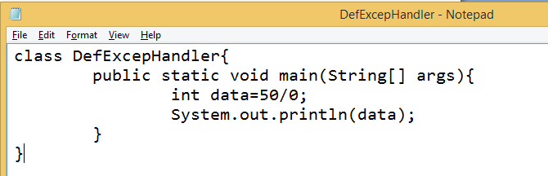
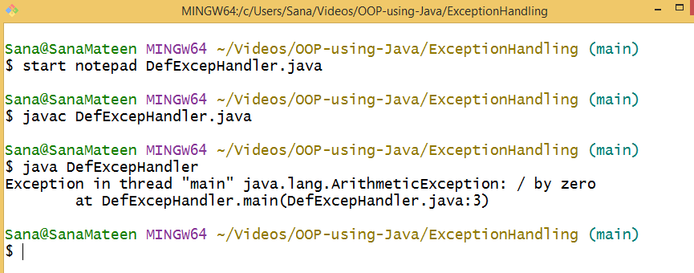

Slide 7
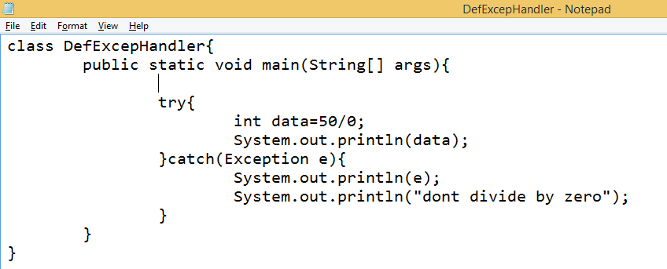
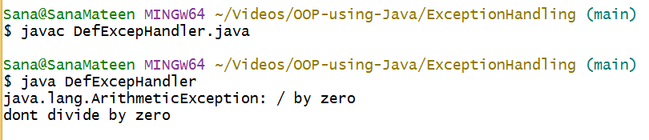

Slide 8
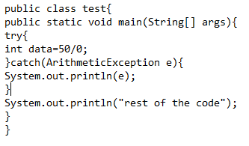
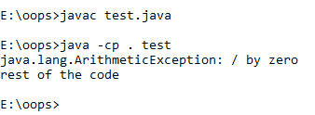
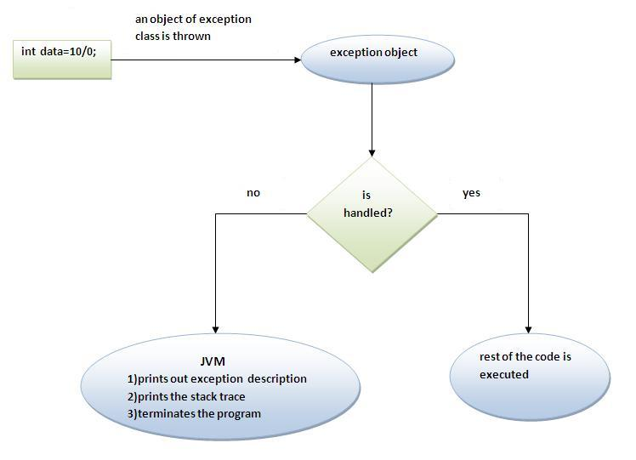

Slide 9
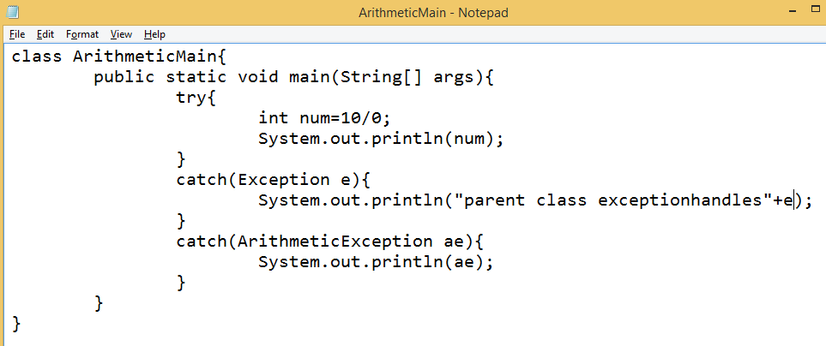
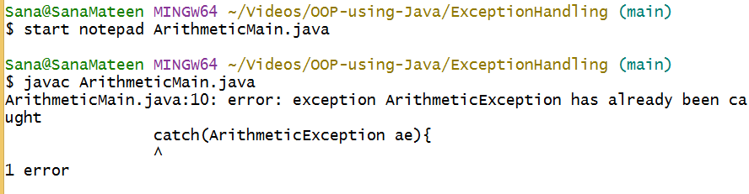

Slide 10
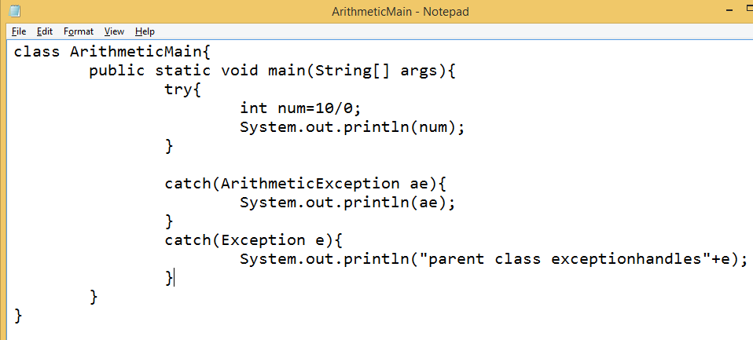
Execute And tell the answer…?

Slide 11
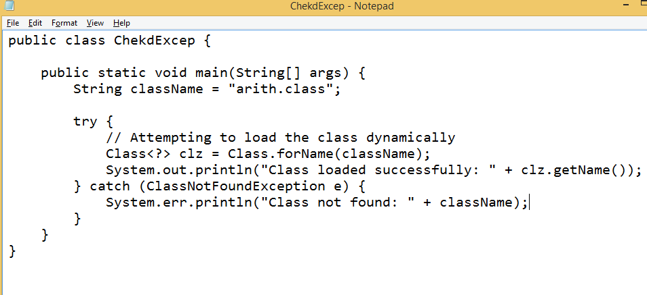
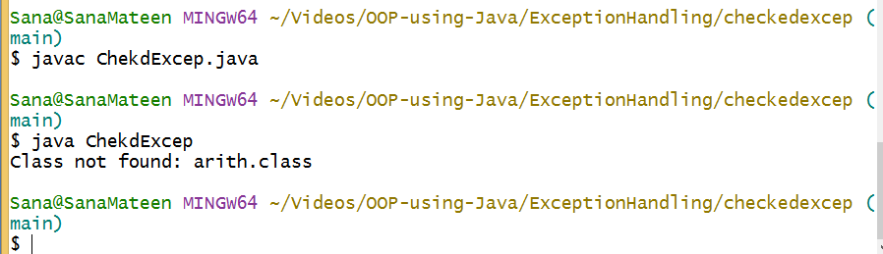

Slide 12
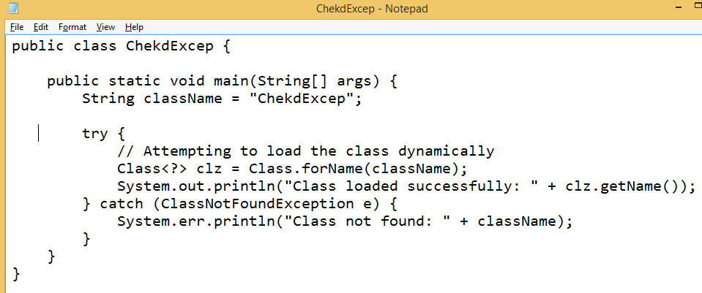
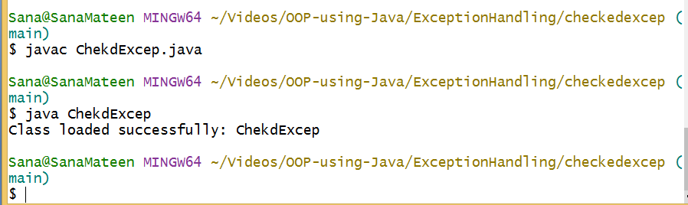

Slide 13
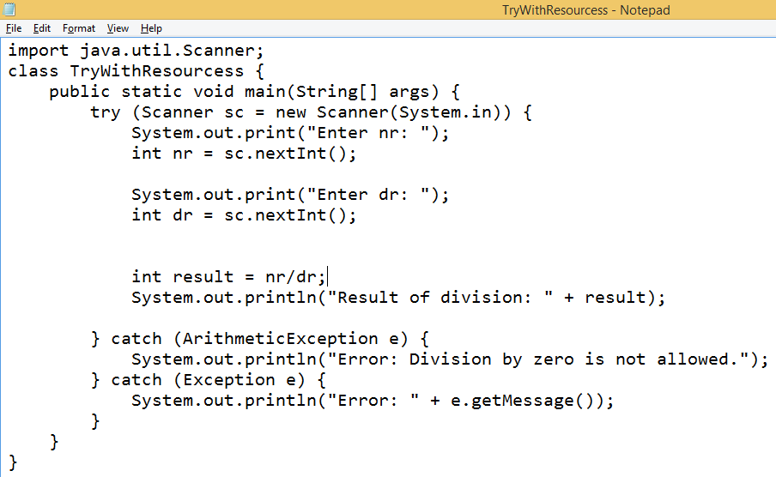
Performs automatic resource management

Slide 14
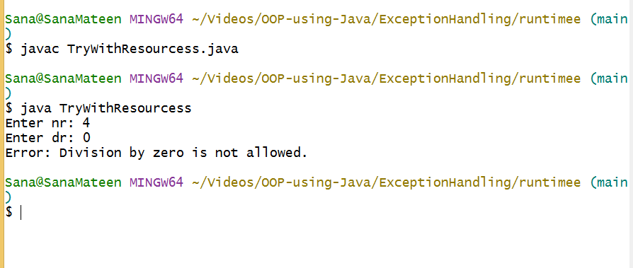

Slide 15
Difference between checked and unchecked exceptions
1) Checked Exception
The classes that extend Throwable class except RuntimeException and Error are known as checked exceptions e.g.IOException, SQLException etc. Checked exceptions are checked at compile-time.
2) Unchecked Exception
The classes that extend RuntimeException are known as unchecked exceptions e.g. ArithmeticException, NullPointerException, ArrayIndexOutOfBoundsException etc. Unchecked exceptions are not checked at compile-time rather they are checked at runtime.
3) Error
Error is irrecoverable e.g. OutOfMemoryError, VirtualMachineError, AssertionError etc.

Slide 16
Common scenarios where exceptions may occur
1) Scenario where ArithmeticException occurs
If we divide any number by zero, there occurs an ArithmeticException.
int a=50/0;//ArithmeticException
2) Scenario where NullPointerException occurs
If we have null value in any variable, performing any operation by the variable occurs an NullPointerException.
String s=null;
System.out.println(s.length());//NullPointerException
3) Scenario where NumberFormatException occurs
The wrong formatting of any value, may occur NumberFormatException. Suppose I have a string variable that have characters, converting this variable into digit will occur NumberFormatException.
String s="abc";
int i=Integer.parseInt(s);//NumberFormatException
4) Scenario where ArrayIndexOutOfBoundsException occurs
If you are inserting any value in the wrong index, it would result ArrayIndexOutOfBoundsException as shown below:
int a[]=new int[5];
a[10]=50; //ArrayIndexOutOfBoundsException

Slide 17
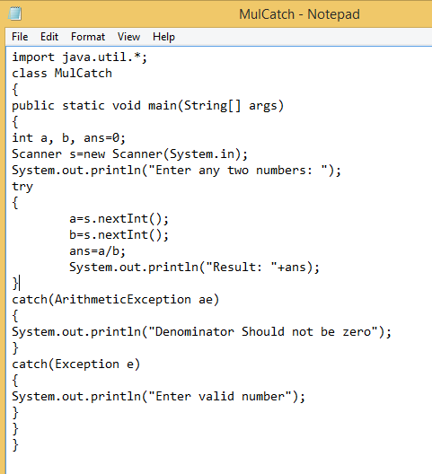
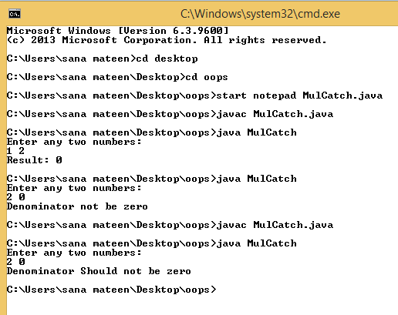

Slide 18
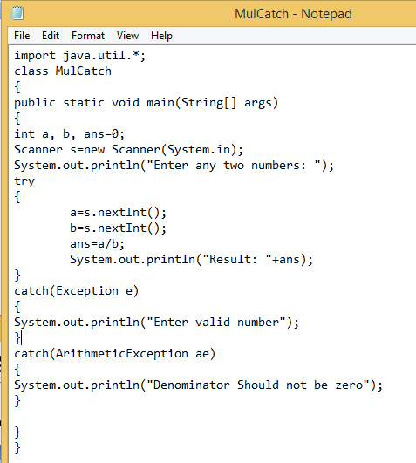
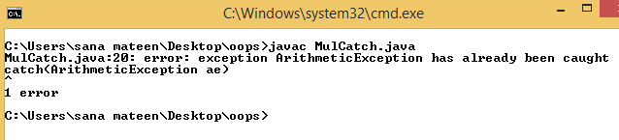

Slide 19
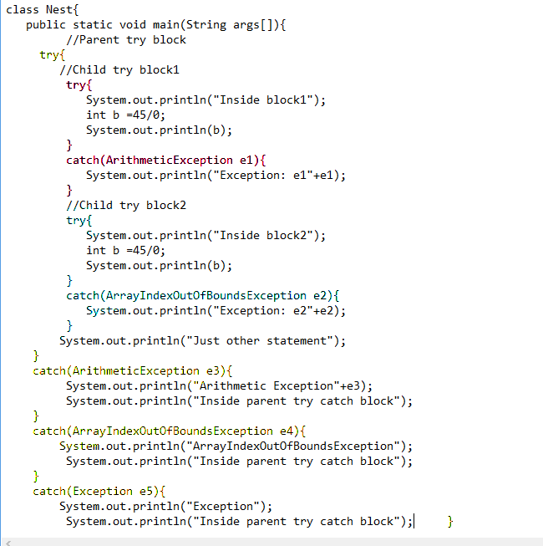

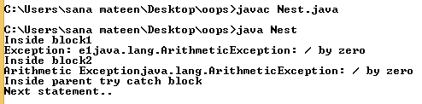

Slide 20
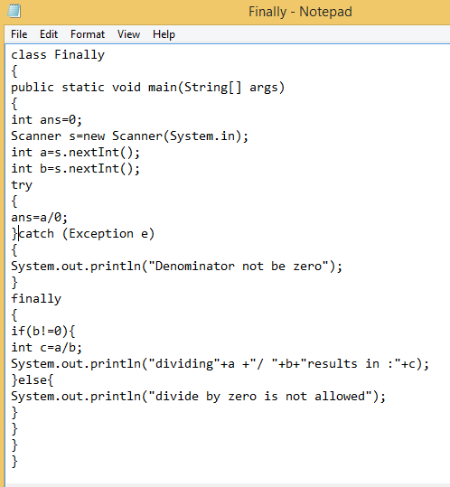
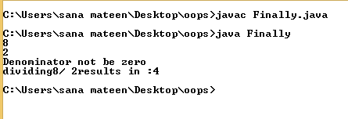

Slide 21
throw keyword
The Java throw keyword is used to explicitly throw an exception.
We can throw either checked or uncheked exception in java by throw keyword. The throw keyword is mainly used to throw custom exception.
The syntax of java throw keyword is given below.
throw exception;
Let's see the example of throw IOException.
throw new IOException("sorry device error);

Slide 22
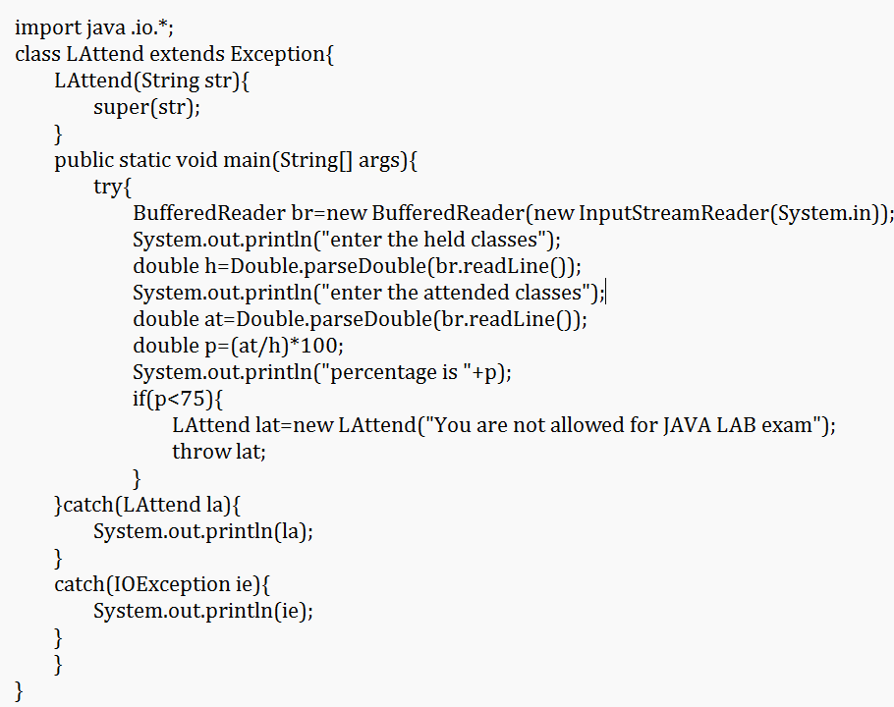

Slide 23
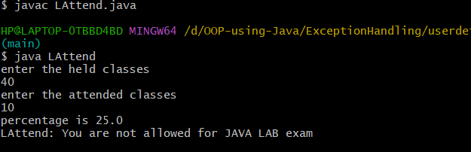
The BufferedReader class in Java is used to read text from an input stream, buffering characters so as to provide efficient reading of characters, arrays, and lines.
The InputStreamReader class is a bridge from byte streams to character streams. It reads bytes and decodes them into characters

Slide 24
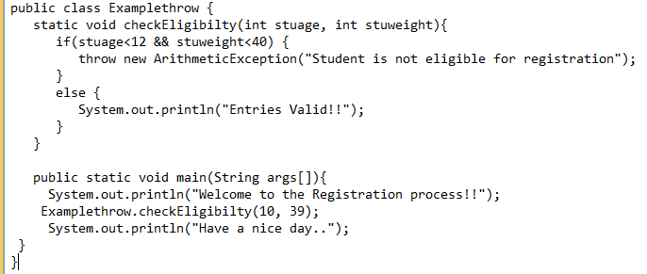

Slide 25
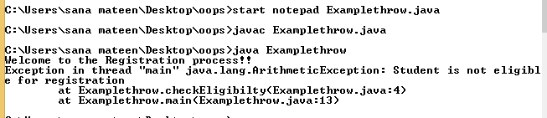

Slide 26
throws keyword
“Throws keyword” is mainly used for handling checked exception as using throws we can declare multiple exceptions in one go.
The throws keyword is used in method declaration, in order to explicitly specify the exceptions that a particular method might throw.
When a method declaration has one or more exceptions defined using throws clause then the method-call must handle all the defined exceptions.

Slide 27
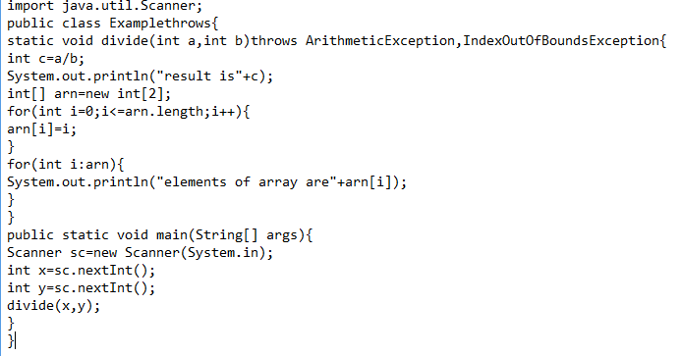

Slide 28



Slide 29
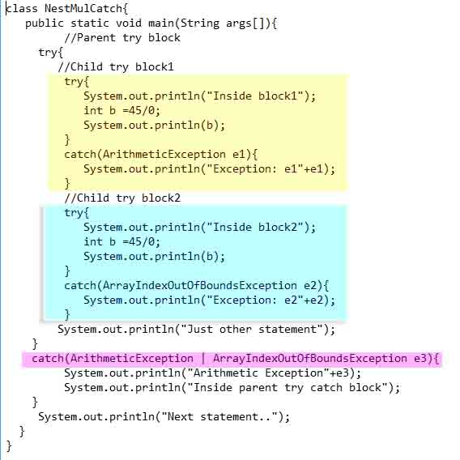

Slide 30
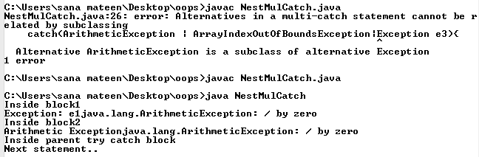

Slide 31
Creating your own exceptions
If you are creating your own Exception that is known as custom exception or user-defined exception. Java custom exceptions are used to customize the exception according to user need.
By the help of custom exception, you can have your own exception and message.

Slide 32
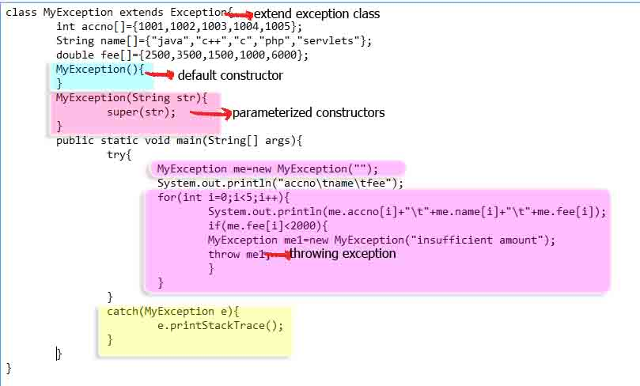

Slide 33
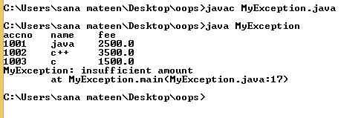

Slide 34
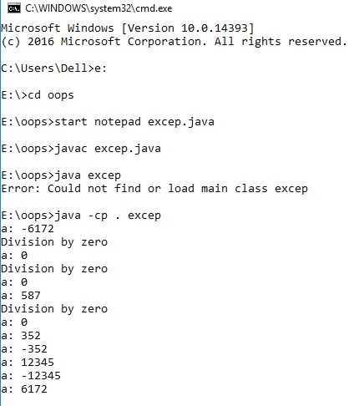
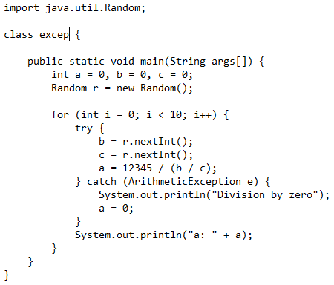
Advantages of Exception Handling
Provision to Complete Program Execution:
One of the important purposes of exception handling in Java is to continue program execution after an exception is caught and handled. The execution of a Java program does not terminate when an exception occurs. Once the exception is resolved, program execution continues till completion.
By using well-structured try, catch, and finally blocks, you can create programs that fix exceptions and continue execution as if there were no errors. If there is a possibility of more than one exception, you can use multiple catch blocks to handle the different exceptions.

Slide 35

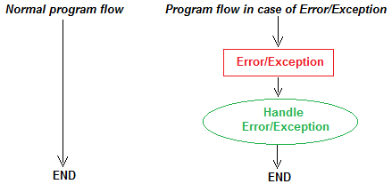
Easy Identification of Program Code and Error-Handling Code
Propagation of Errors
Meaningful Error Reporting

Slide 36
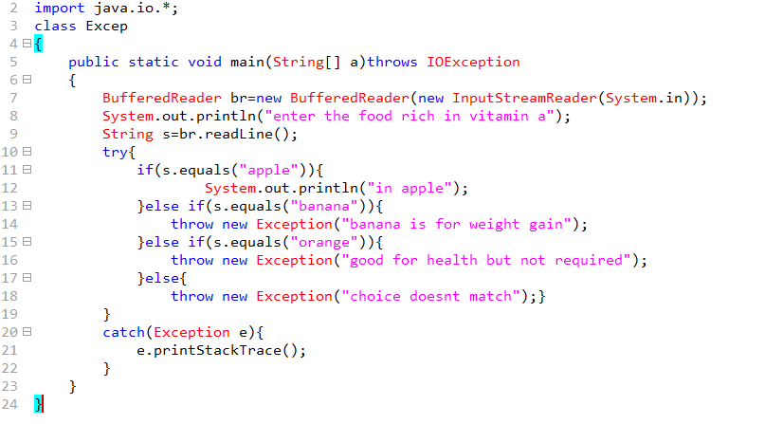

Slide 37
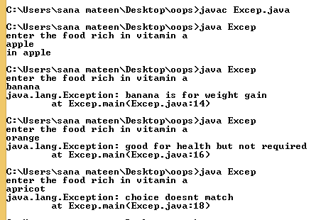

Slide 38
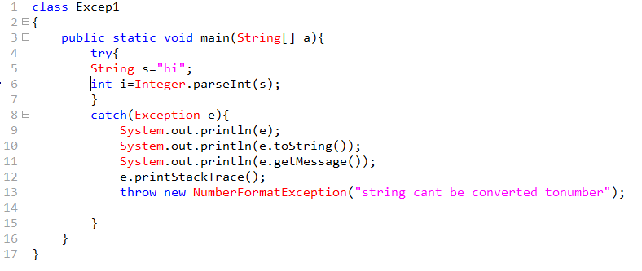

Slide 39
